Slide 1
Group members :
Sweta Joshi
Sakshi Dalal
Rimple Poonia Dabas

Slide 2
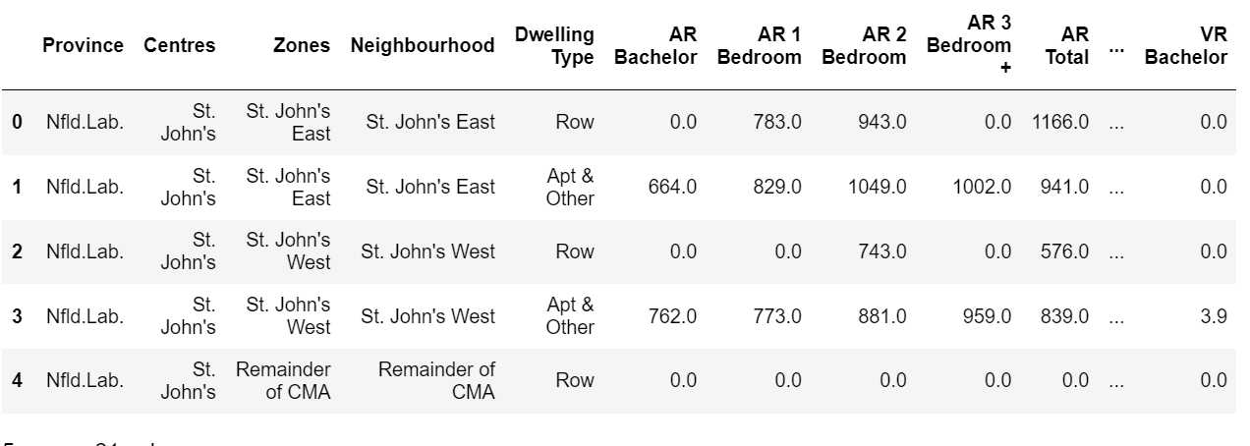

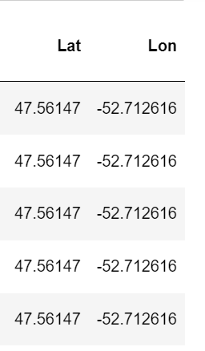

Extract
Transform
Load
App
Data extraction

Slide 3



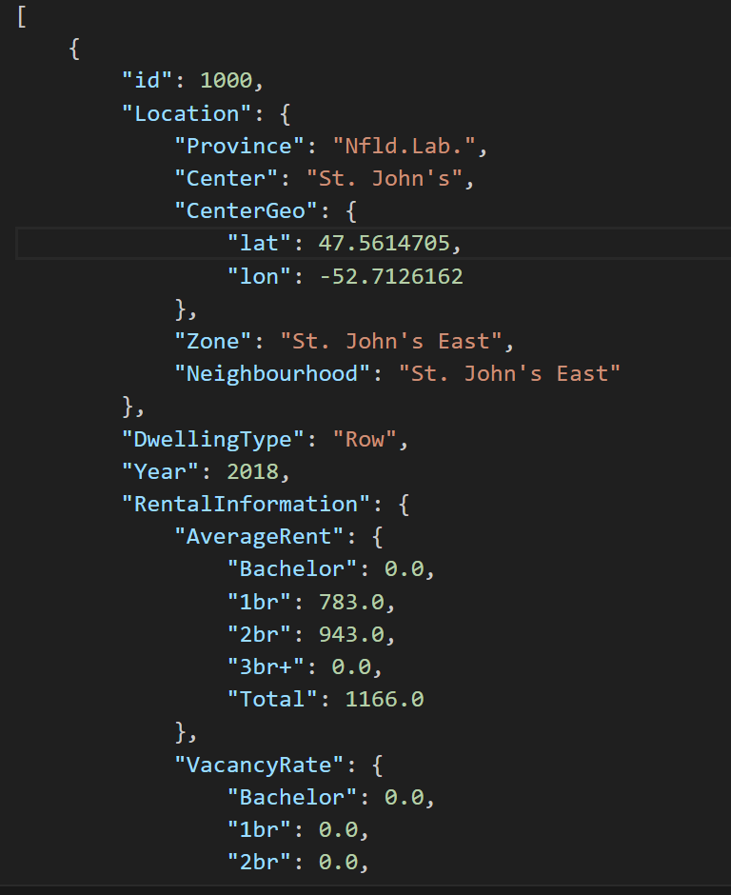
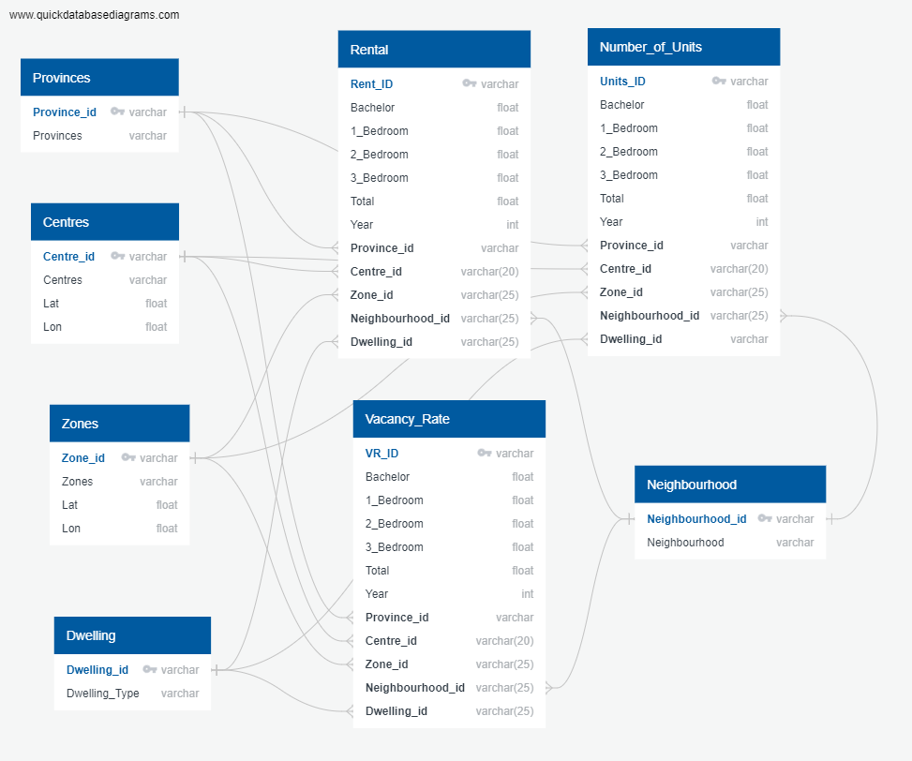
Extract
Transform
Load
App
Data Transformation
Original Data
Json and csv files

Slide 4


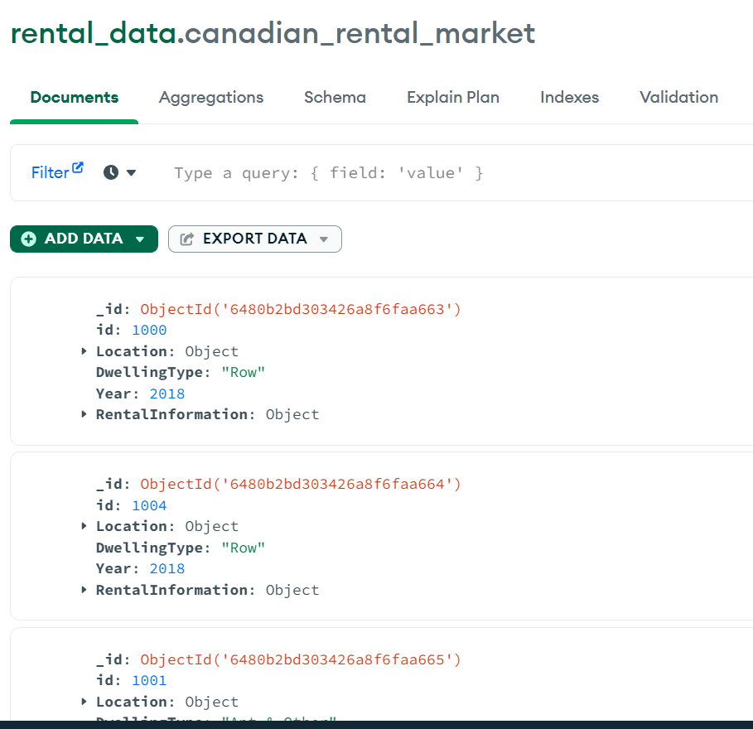
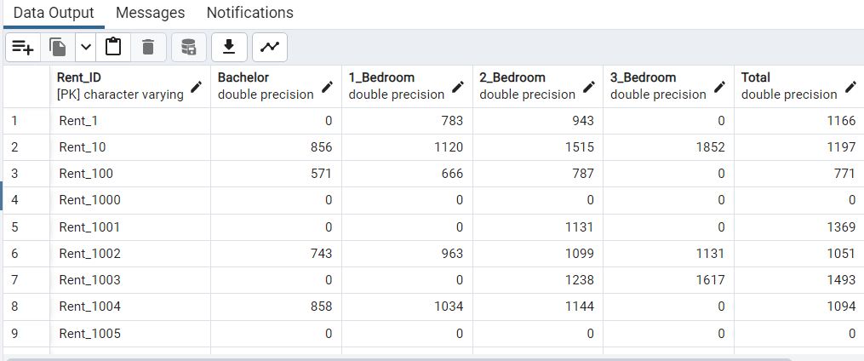
Extract
Transform
Load
App
Data Load
Non-Relational
Relational

Slide 5
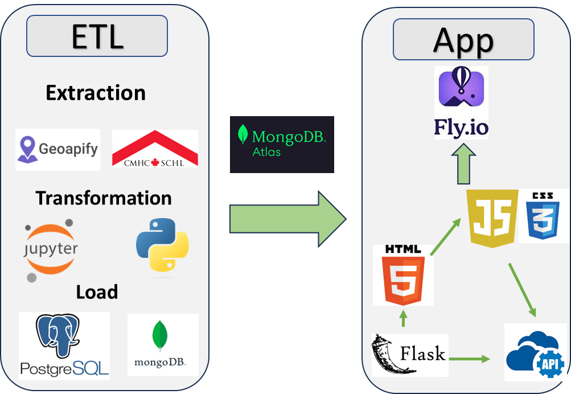
Extract
Transform
Load
App
APP

Slide 6










ETL
App
Extraction
Transformation
Load

Slide 7





Slide 8


